Slide 1



Smart City Transportation

Slide 2
OUR TEAM
Menna Allah Osama 23102157
Catherine Adel Zaki 23102369
Arwa Mohey 23101371
Soha Hossam 23101397
Mariam Nady 23101481
Samira Saed 23101395
Veronica wassim 23102401

Slide 3
INTRODUCTION
The Smart City Transportation Network Optimization project focuses on solving transportation challenges in Greater Cairo using advanced algorithmic techniques. The system integrates graph algorithms, shortest path optimization, dynamic programming, and greedy methods to improve traffic management, emergency routing, and public transportation efficiency. Our project simulates real transportation scenarios and provides optimized routing solutions under varying traffic conditions.

Slide 4

Features
Transportation network graph representation
Traffic flow optimization
Emergency vehicle routing
Public transportation scheduling
Congestion-aware route planning
Real-time traffic simulation

Slide 5
Features
Transportation network graph representation
Traffic flow optimization
Emergency vehicle routing
Public transportation scheduling
Congestion-aware route planning
Real-time traffic simulation

Slide 6
Why Dijkstra’s Algorithm?
Dijkstra’s Algorithm
Efficient shortest path computation
Suitable for weighted road networks
Works well for GPS-style navigation
Easy to adapt for transportation systems
Supports traffic-based modifications
Dijkstra’s Algorithm is a greedy shortest path algorithm used to compute the minimum distance between a source node and all other nodes in a weighted graph. The algorithm repeatedly selects the node with the smallest known distance and updates neighboring distances through edge relaxation.

Slide 7

Main Characteristics
Greedy algorithm
Works on weighted graphs
Requires non-negative edge weights
Produces optimal shortest paths
Uses a priority queue for efficiency

Slide 8
Graph Representation
In our transportation system, the road network is modeled as a weighted graph where intersections are represented as vertices and roads are represented as weighted edges. Edge weights represent travel time, distance, or congestion cost between locations.

Slide 9
Mathematical Foundation
Graph Representation
Vertices → Intersections / Locations
Edges → Roads
Weights → Travel time or distance
Source node → Starting location
Destination node → Target location
G=(V,E,w)
V = set of vertices
E = set of edges
w = edge weight function
Dijkstra’s Algorithm is based on the principle of optimal substructure, which states that every sub-path of a shortest path is itself a shortest path. The algorithm also relies on the relaxation process to continuously improve distance estimates until the optimal shortest distances are finalized.

Slide 10
Core Mathematical Concepts
Optimal substructure
Relaxation invariant
Priority queue ordering
Greedy selection strategy
d[v]>d[u]+w(u,v)
If a shorter path through node u is found, the distance of node v is updated.

Slide 11
Relaxation Process
Steps:
Select the node with minimum distance
Visit all neighboring nodes
Calculate new possible distances
Update shorter distances
Repeat until all nodes are processed
d[v]=d[u]+w(u,v)

Slide 12
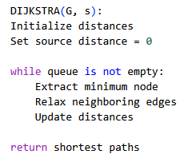
Algorithm Pseudocode

Slide 13
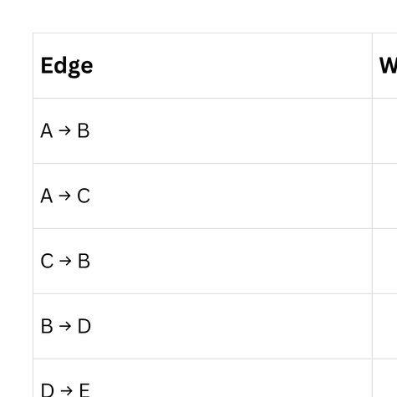
The following example demonstrates how Dijkstra’s Algorithm computes shortest paths from source node A to all other nodes in the transportation network.
Start from node A
Update neighboring distances
Select minimum distance node
Continue relaxation process
Final shortest paths obtained

Slide 14
Proof of Correctness
Dijkstra’s Algorithm guarantees the optimal shortest path because once a node is extracted from the priority queue, its shortest distance becomes finalized. Since all edge weights are non-negative, no shorter alternative path can appear later during execution.
Non-negative edge weights
Greedy minimum selection
Relaxation preserves shortest distances
Priority queue guarantees correct ordering

Slide 15
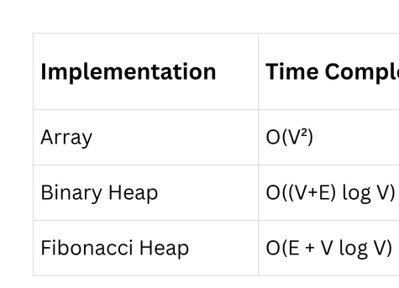
Time Complexity Analysis
The performance of Dijkstra’s Algorithm depends on the data structure used for the priority queue. Binary heaps significantly improve efficiency for sparse transportation graphs.
O((V+E)logV)

Slide 16
Space Complexity
The algorithm stores graph data structures, distance arrays, predecessor arrays, and priority queue information. Therefore, the total space complexity depends on the number of vertices and edges in the transportation network.
Space Usage:
Distance array
Priority queue
Graph adjacency list
Previous node tracking
O(V+E)

Slide 17
Our Transportation Modifications
To adapt Dijkstra’s Algorithm for real transportation systems, several modifications were introduced to account for traffic congestion, road closures, and emergency routing requirements. These modifications improve route realism and optimization accuracy.

Slide 18
Modifications Added:
Traffic-based edge weights
Rush hour congestion penalties
Emergency vehicle prioritization
Road closure handling
Alternative route recommendation
Adjusted Cost=Distance+Traffic Penalty

Slide 19
Performance Analysis
Performance testing demonstrated that the modified Dijkstra implementation successfully reduced travel time and improved routing efficiency under varying traffic conditions.
Results:
Faster route generation
Reduced congestion impact
Improved emergency response
Efficient shortest path calculation
Better traffic-aware navigation

Slide 20
Comparison with Other Algorithms
Why Dijkstra’s Algorithm?
Dijkstra’s Algorithm was selected because it efficiently computes the shortest path in weighted transportation networks with non-negative edge weights. In smart city transportation systems, finding optimal routes quickly is essential for reducing travel time,minimizing congestion, and improving emergency response efficiency.
Dijkstra
Optimal shortest path
Slower on huge graphs
A*
Faster with heuristic
Needs heuristic
Bellman-Ford
Handles negative weights
Higher complexity

Slide 21
Why Dijkstra’s Algorithm?
Challenges Faced
Challenges
Large transportation graph size
Dynamic traffic conditions
Real-time route updates
Memory optimization
Congestion simulation complexity
Solutions
Used adjacency lists
Priority queue optimization
Traffic-based weighting
Efficient graph traversal
Efficient shortest path computation
Suitable for weighted road networks
Works well for GPS-style navigation
Easy to adapt for transportation systems
Supports traffic-based modifications

Slide 22

Future Improvements
Future improvements can further enhance the transportation optimization system by integrating machine learning models, real-time GPS tracking, and predictive traffic analysis.
Future Work
AI traffic prediction
Real-time GPS integration
Smart traffic signals
Parallel route computation
Cloud deployment

Slide 23
CONCLUSION
Dijkstra’s Algorithm provided an effective solution for transportation route optimization within our smart city system. Through graph modeling, shortest path computation, and traffic-aware modifications, the algorithm successfully improved routing efficiency and transportation management performance.
Key Takeaways
Efficient shortest path computation
Strong mathematical foundation
Real-world transportation applications
Scalable transportation optimization

Slide 24
THANK
YOU

